Slide 1




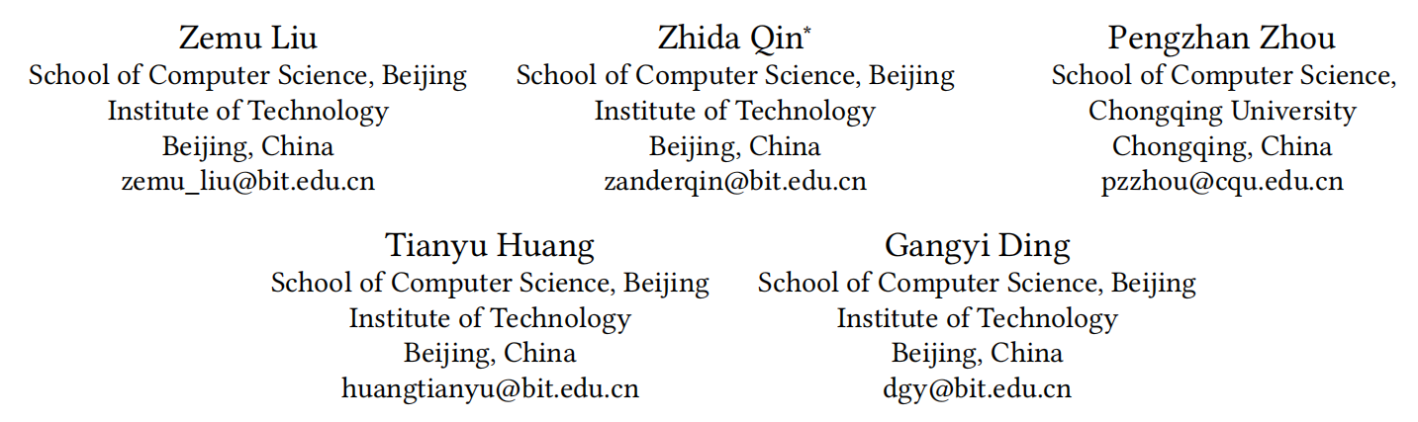



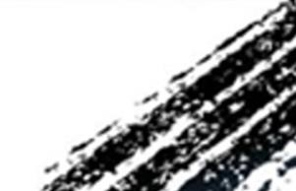

ATAI
Advanced Technique of Artificial Intelligence
ATAI
ChongqingUniversity _{AdvancedTechniqueof}
of Technology Artificial Intelligence
Chongqing University of Technology
Chongqing University ^{ATAI}
_{of Technology} Advanced Techniqueof
Artificial Intelligence
Chongqing University of Technology
Chongqing University of Technology
Bridging Time and Domains:A Time-aware Framework for
Cross-Domain Sequential Recommendation
—— WWW ’26
Reported by Xin H.
1
Notes:
利用大语言模型弥补知识感知推荐中的用户侧知识差距

Slide 2
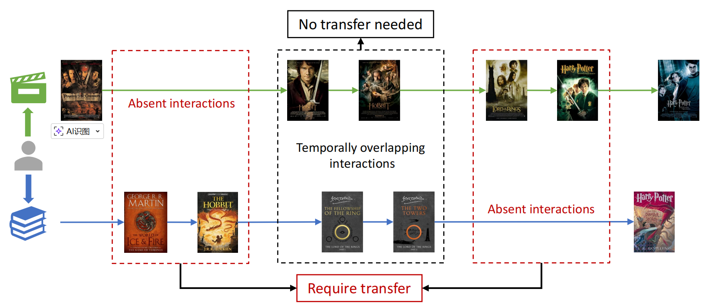
Motivation
ATAI
Advanced Technique of
Artificial Intelligence
ATAI
ChongqingUniversity _{AdvancedTechniqueof}
of Technology Artificial Intelligence
Chongqing University of Technology
经典的跨域序列推荐忽略了用户偏好的时间分布，阻碍了模型准确捕捉用户不断变化偏好的能力。
(i) 序列中的交互在时间上是非均匀分布的；如上图所示，用户交互在时间上并非均匀分布。用户频繁地将交互集中在短暂的时间段内，而长时间内缺乏交互，这进一步加剧了交互的稀疏性。以往的研究表明，由于偏好漂移问题（即用户偏好可能随时间发生变化），非均匀分布不利于捕捉用户偏好。
(ii) 忽略了跨域迁移过程中的时间影响。当用户在两个域中都表现出丰富的交互时，模型应在此期间减少跨域偏好迁移，以减轻域特定信息可能带来的干扰。反之，当目标域的交互稀疏时，模型应积极地从源域迁移相关偏好，以弥补交互的不足并辅助目标域的推荐。

Slide 3
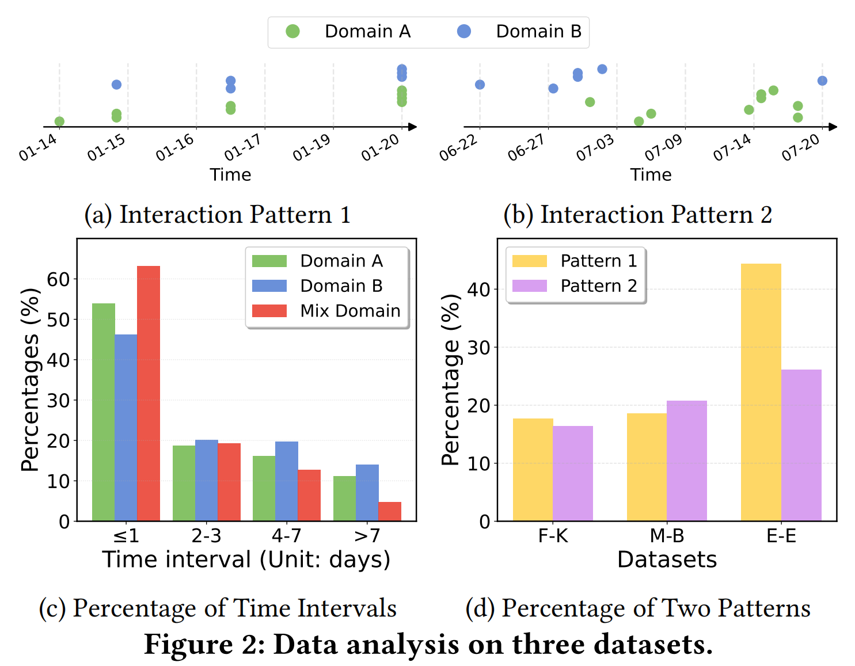
Motivation
ATAI
Advanced Technique of
Artificial Intelligence
ATAI
ChongqingUniversity _{AdvancedTechniqueof}
of Technology Artificial Intelligence
Chongqing University of Technology
数据分析
a图代表模式1，即A领域和B领域的交互在时间上重叠。
b图代表模式2，A领域和B领域的交互在时间上不重叠。
c图代表领域序列中两个item之间的时间间隔，Mix Domain代表两个领域的序列合并后的时间间隔。
d图表示在(i) Food-Kitchen, (ii) Movie-Book, (iii) Entertainment-Education三个数据集上的模式分布。

Slide 4
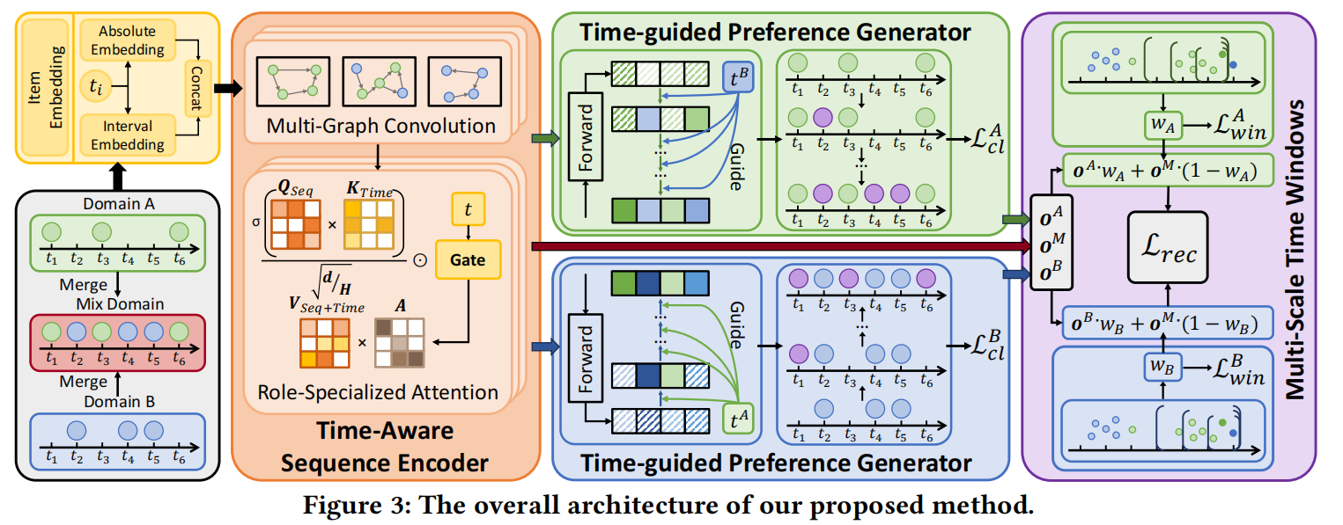
Overview
ATAI
Advanced Technique of
Artificial Intelligence
ATAI
ChongqingUniversity _{AdvancedTechniqueof}
of Technology Artificial Intelligence
Chongqing University of Technology
主要分为4个模块时间嵌入层，序列编码，偏好生成，偏好时间窗口

Slide 5
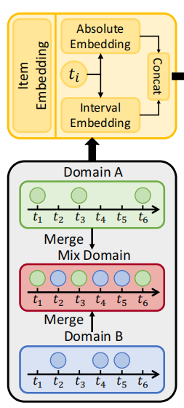








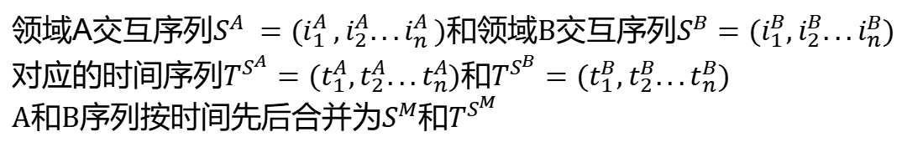
Method
ATAI
Advanced Technique of
Artificial Intelligence
ATAI
ChongqingUniversity _{AdvancedTechniqueof}
of Technology Artificial Intelligence
Chongqing University of Technology
时间嵌入层
领域A交互序列$S^{A}=(i_{1}^{A},i_{2}^{A}...i_{n}^{A})$和领域B交互序列$S^{B}=(i_{1}^{B},i_{2}^{B}...i_{n}^{B})$
对应的时间序列$T^{S^{A}}=(t_{1}^{A},t_{2}^{A}...t_{n}^{A})$和$T^{S^{B}}=(t_{1}^{B},t_{2}^{B}...t_{n}^{B})$
A和B序列按时间先后合并为$S^{M}$和$T^{S^{M}}$
1.物品编码
为每个域(A、B、M)分配一个矩阵M，得到各自表示$E^{A}、E^{B}{、E}^{M}$
2.时间编码
编码绝对时间
编码时间间隔
融合绝对时间和时间间隔信息

Slide 6
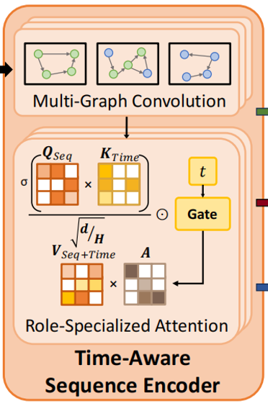
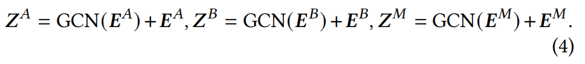

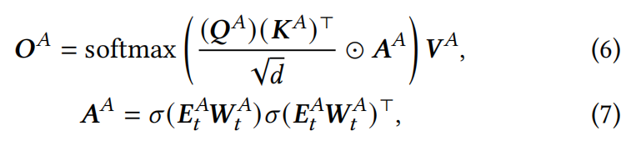



Method
ATAI
Advanced Technique of
Artificial Intelligence
ATAI
ChongqingUniversity _{AdvancedTechniqueof}
of Technology Artificial Intelligence
Chongqing University of Technology
Time-Aware Sequence Encoder (TASE)
获取域A、B、M的邻接矩阵，再用图卷积学习物品间的相互关系
变种自注意力机制融合信息
加入时间门控机制，用$A^{A}$来引入时间门控，控制应该更关注哪个时间段
接着再进行K层上述的自注意力过程，完成序列编码

Slide 7
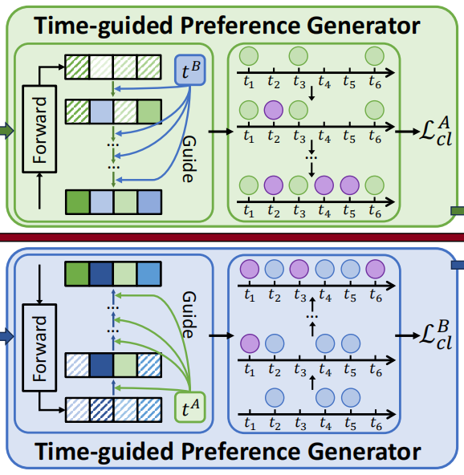
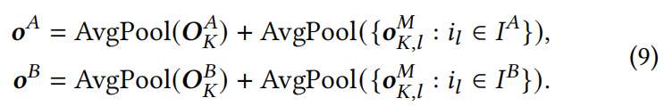

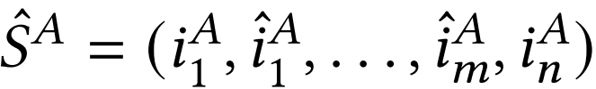

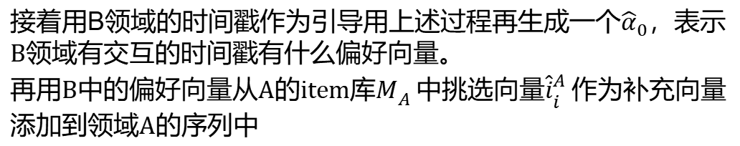
Method
ATAI
Advanced Technique of
Artificial Intelligence
ATAI
ChongqingUniversity _{AdvancedTechniqueof}
of Technology Artificial Intelligence
Chongqing University of Technology
Time-guided Preference Generator (TGPG)
先将序列表示均值作为用户整体目标偏好
用余弦函数对每个时间戳$t_{i}$编码
进行标准前向加噪过程后进行去噪回到$o^{A}$
接着用B领域的时间戳作为引导用上述过程再生成一个${\hat{α}}_{0}$，表示B领域有交互的时间戳有什么偏好向量。
再用B中的偏好向量从A的item库$M_{A}$中挑选向量${\hat{i}}_{i}^{A}$作为补充向量添加到领域A的序列中
扩充后得到增强序列
把同一批次的其他用户序列作为负样本进行对比学习

Slide 8

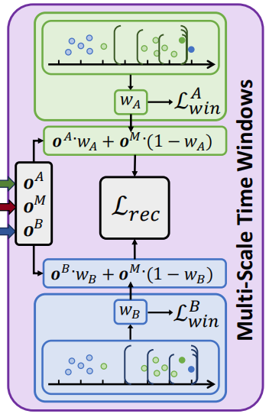


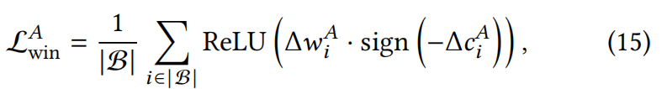
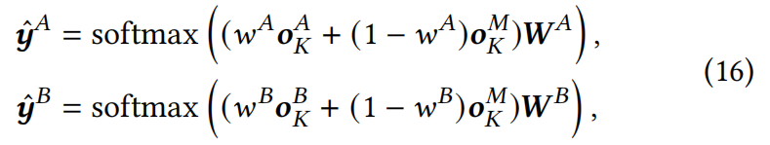

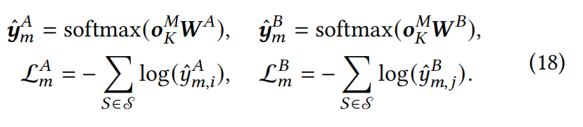
Method
ATAI
Advanced Technique of
Artificial Intelligence
ATAI
ChongqingUniversity _{AdvancedTechniqueof}
of Technology Artificial Intelligence
Chongqing University of Technology
Multi-Scale Time Windows Based Domain Transfer (MTDT)
设置了3种大小的时间窗口，计算窗口中的交互频率，根据频率算权重
确保交互频率低的领域则权重小，采样多个频率权重对
计算差值
下面为预测任务损失函数

Slide 9
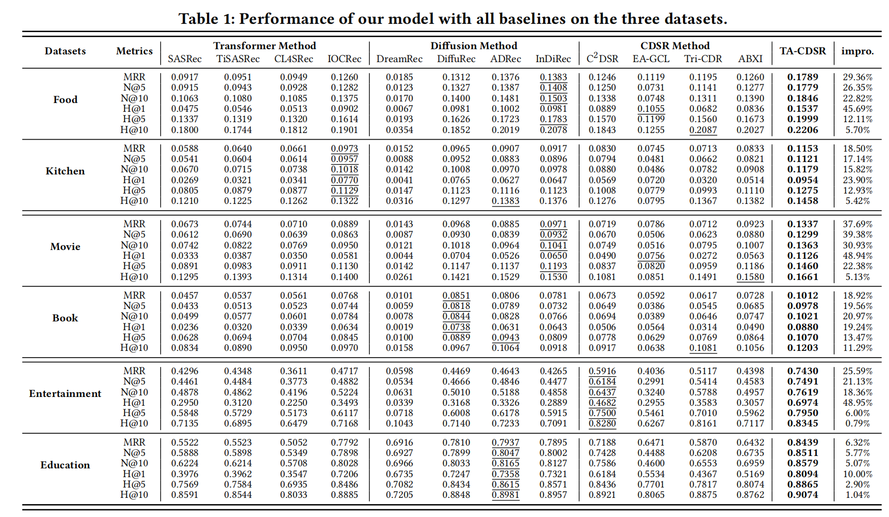
Experiments
ATAI
Advanced Technique of
Artificial Intelligence
ATAI
ChongqingUniversity _{AdvancedTechniqueof}
of Technology Artificial Intelligence
Chongqing University of Technology

Slide 10
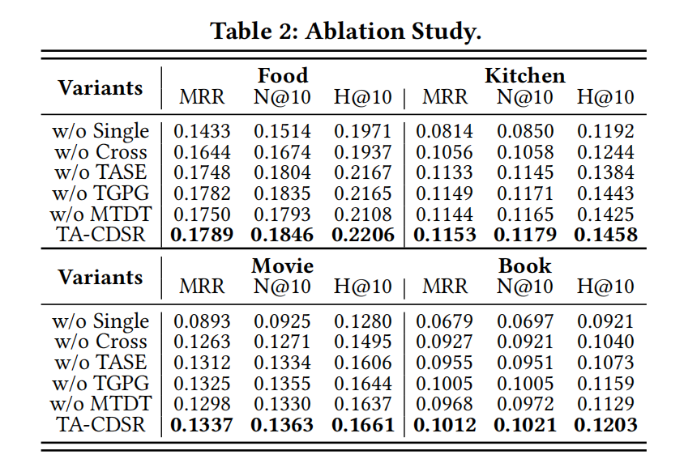
Experiments
ATAI
Advanced Technique of
Artificial Intelligence
ATAI
ChongqingUniversity _{AdvancedTechniqueof}
of Technology Artificial Intelligence
Chongqing University of Technology
w/o Single:Remove domain-specific embeddings ,only use domain-shared embeddings for prediction.
•w/o Cross:Remove domain-shared embeddings ,only use domain-specific embeddings for prediction.
•w/o TASE:Replace time-sensitive attention with standard
self-attention.
•w/o TGPG:Remove time-guided preference generator.
•w/o MTDT:Remove multi-scale windows based domain
transfer module.

Slide 11
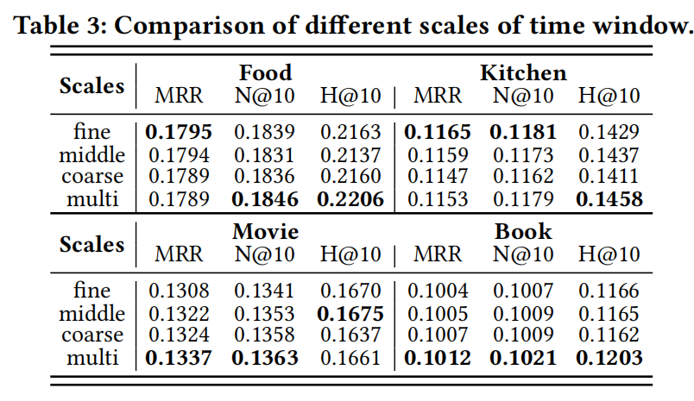
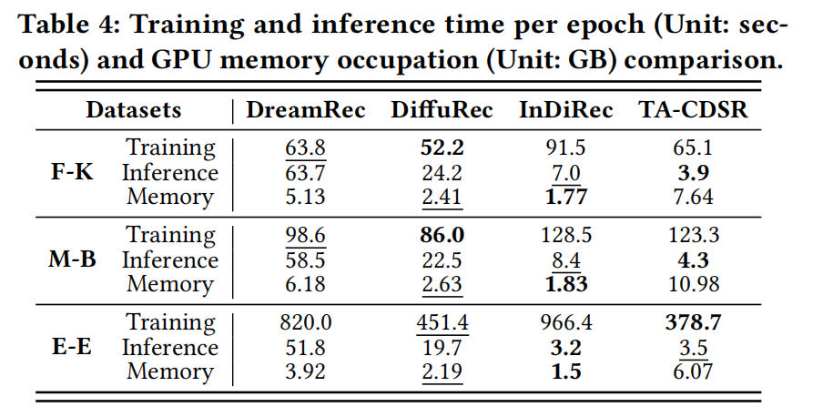
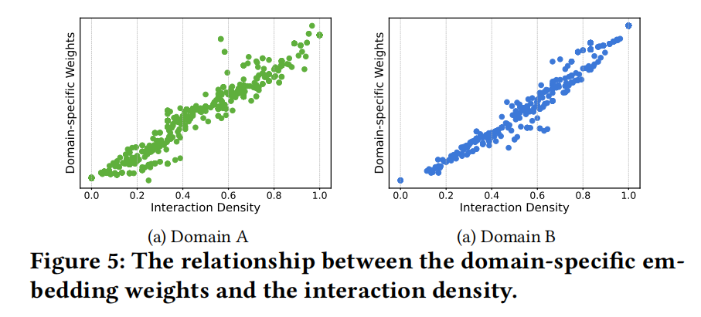
Experiments
ATAI
Advanced Technique of
Artificial Intelligence
ATAI
ChongqingUniversity _{AdvancedTechniqueof}
of Technology Artificial Intelligence
Chongqing University of Technology

Slide 12


ATAI
Advanced Technique of
Artificial Intelligence
ATAI
ChongqingUniversity _{AdvancedTechniqueof}
of Technology Artificial Intelligence
Chongqing University of Technology
Thanks!

